Slide 1

Liquor store Analysis
Govind Dogra

Slide 2
INTRODUCTION
Analyzed Bibbitor LLC dataset from PwC to understand sales, inventory, and purchasing trends. The dataset includes:
Sales – 12M+ transaction records
Final Purchase – Product purchase details
Beg_Inventory and End_Inventory – Beginning and ending stock levels
Invoices – Sales and purchase invoices

Slide 3
PROJECT STAGES:
Data Cleaning (Python)
Data Warehousing (SNOWFLAKE)
ANALYSIS AND Dashboard (SQL AND POWER BI)

Slide 4
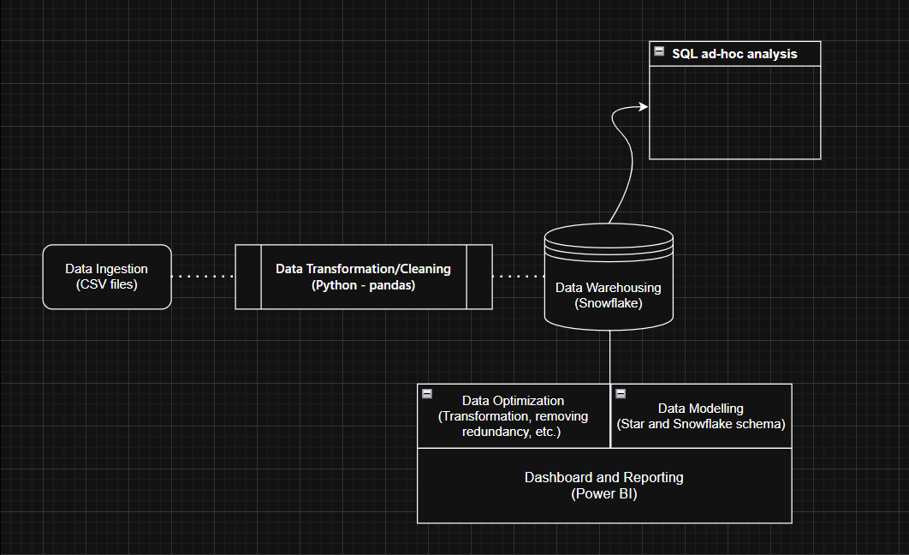
DATA FLOW

Slide 5
DATA CLEANING - PYTHON
Imputed Missing Values
Filled null values in fact tables using mean volume within the same price range.
Used dimension tables with primary keys to impute missing entries consistently.
Standardized Volume Formats Unified inconsistent formats, e.g.:
'750mL + 3/' → '750mL 3 Pk'
'750mL + 2/' → '750mL 2 Pk’
'Liter' → ‘1L’
Corrected Inventory IDs Reconstructed InventoryId when city was missing by combining: Store + City + Brand. Example: 46__62 → 46_TYWARDREATH_62.
Imputed Missing City Names Filled null values in City column of ending inventory using data from beginning inventory, matched by Store.

Slide 6
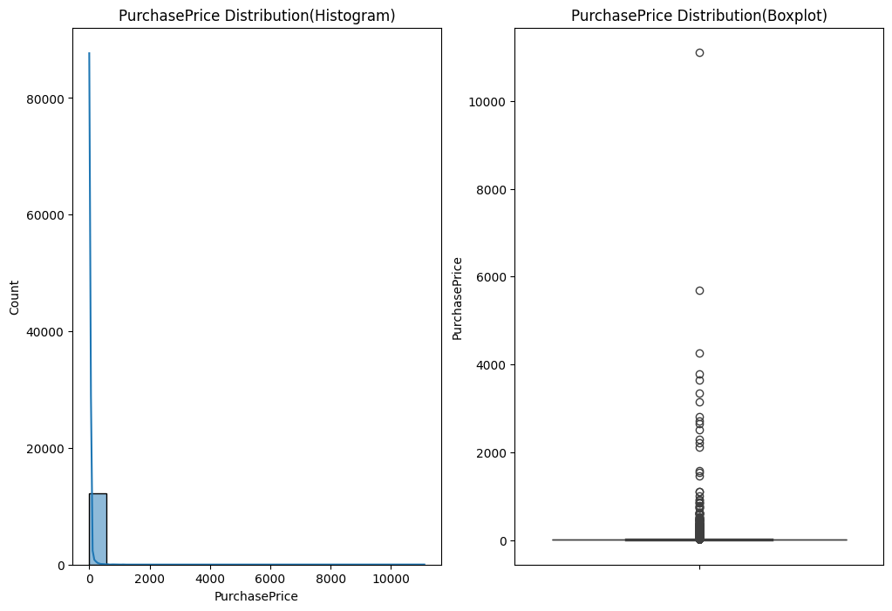
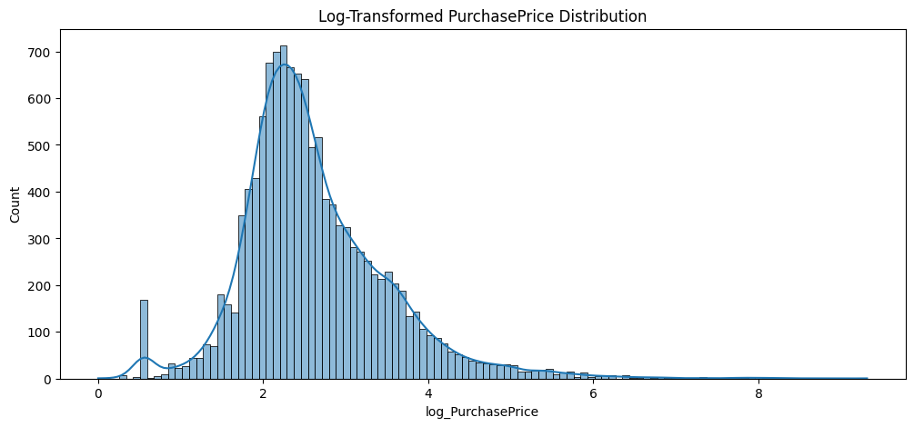
DATA EXPLORATION
Applied log transformation to normalize skewed data
75% of products are priced below $30; only 5% exceed $95.99.
Boxplot & histogram show most values are low, with a few high-priced outliers skewing the distribution.

Slide 7
DATA WAREHOUSING - SNOWFLAKE
Data Storage in Snowflake
Created a Schema in Snowflake to organize project data.
Designed tables to store:
Purchase Prices
Beginning Inventory
Ending Inventory
Purchases
Sales
Vendor Invoices
Uploaded cleaned data into respective tables.
Enabled reporting & ad-hoc analysis using SQL queries.
Provided a centralized, scalable warehouse for analysis and dashboarding

Slide 8
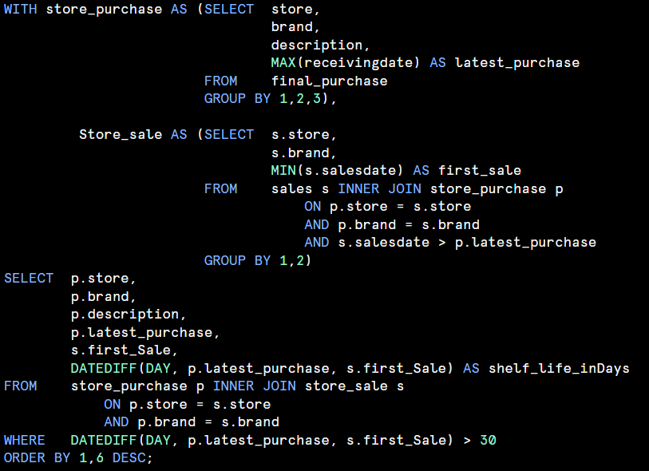
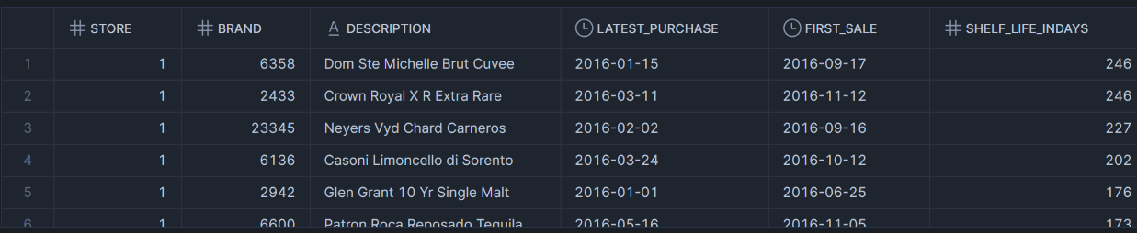
Few AD-Hoc Requests
Products with high Shelf life (No sale in last 30 days)

Slide 9

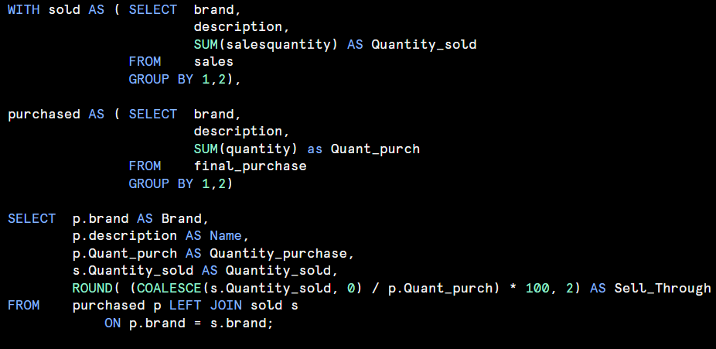
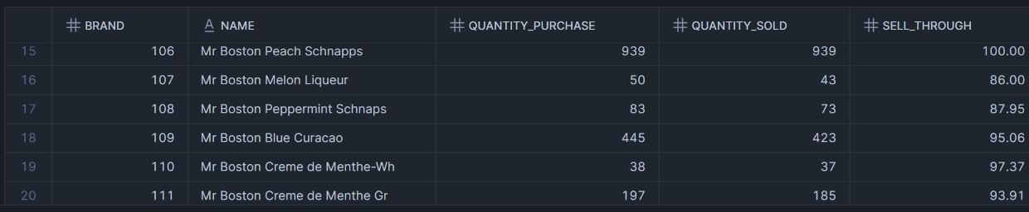
Sell Through rate (%)

Slide 10
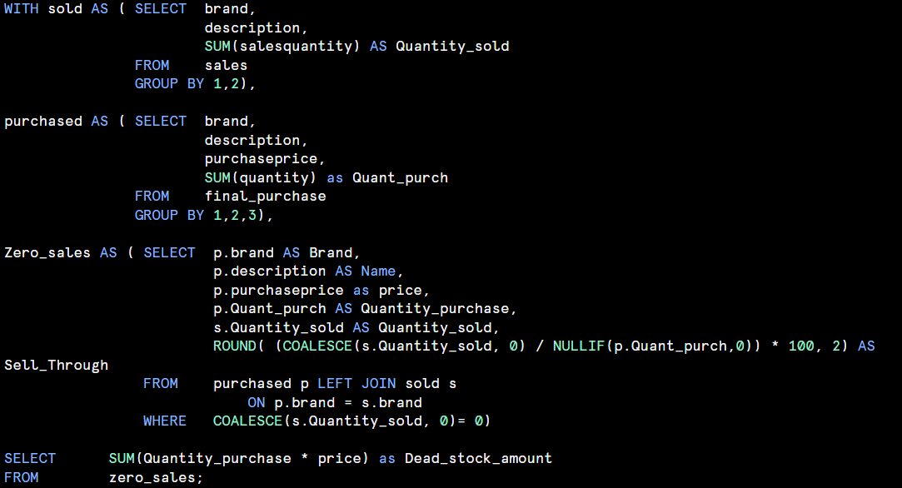

Dead stock amount - Stock with 0 sales

Slide 11
DASHBOARD & REPORTING – POWER BI
Dashboard provides a comprehensive analysis of liquor store performance across sales, profit, and operations with interactive filters for store, month/year, and occasion-based views..
Sales Overview → Summarizes total revenue, profit, gross margin, and KPIs for overall business performance.
Temporal & Seasonal Sales → Shows monthly, seasonal, and occasion-driven sales to identify demand peaks and trends.
Product Performance → Highlights top products, categories (Spirits, Beer, Wines), and profitability drivers.
Store & Vendor Insights → Ranks stores by sales/profit, tracks inventory levels, and evaluates vendor contributions.
Geographic Analysis → Maps store performance globally, comparing revenue and profit across regions.

Slide 12
STAGES
Column Formatting & Standardization Updated column formats (date, numeric, and text fields) to ensure consistency and accuracy.
Data Normalization Product Table: Created a dedicated product dimension table linked to the sales fact table (12M+ rows) via Product ID. - Removed redundant product details from the sales table, reducing size and improving dashboard speed. Date & Occasion Tables: Built a Date Dimension and Occasions table to enable detailed temporal and event-based analysis. Vendor Table: Developed a vendor dimension table with Vendor ID and Vendor Name.
Linked this table across sales, invoices, and purchase datasets.
Removed duplicate vendor name columns from related tables to eliminate redundancy and optimize storage.

Slide 13
Data Modeling
Designed the model using a combination of star and snowflake schema.
Ensured optimized relationships between fact and dimension tables for efficient querying.\
Dashboard Development
Created interactive dashboards covering Sales Overview, Temporal & Seasonal Trends, Product Insights, Store & Vendor Analysis, and Geographic Performance.
Added slicers/filters for store, month/year, and occasion to enable dynamic, user-driven analysis.

Slide 14
Inventory Risk And Performance Analysis
Dead Stock (0% Sell-Through)
Bulk purchases never sold:
Straw Boys Vodka – 1,140 units
Killibinbin Shiraz – 1,044 units
Irony Black Monterey – 1,032 units
Aviary Cab Svgn – 1,017 units
, Many more.
Dead Stock Value: $282,183.65
Implications:
100% holding cost
$282K capital locked, no returns
Storage inefficiency
Expiry risk → liquidation/write-off
Low Sell-Through Items (Slow Movers)
Example: Archivist Gerston Scotch → 25% sell-through
Burden: 75% inventory unsold
Implications:
Slow-moving stock ties up capital
Reduced inventory turnover
Increases holding cost pressure
Shelf Life Concerns
Dom Ste Michelle Brut Cuvee → 246-day shelf life, delayed first sales
Crown Royal XR Extra Rare → similar delay
Implications:
Products not selling within shelf-life cycle
Higher chance of obsolescence
Discounting or write-off becomes inevitable

Slide 15
Inventory Risk And Performance Analysis
High-Demand Products & Stock-Outs
Example: Jack Daniels & Coke → 100% sell-through
Frequent stock-outs during peak demand:
June (summer)
Implications:
Lost sales opportunities
Inventory misalignment
Customer dissatisfaction due to shortages
Vendor & Procurement Gaps
Large purchases (>1,000 units) without validating demand
Lack of vendor performance monitoring
Procurement process lacks accountability

Slide 16
THANK YOU…..
Mail: govinddogra10@gmail.com
LinkedIn: https://www.linkedin.com/in/govind-dogra/

